Slide 1

Urban to Suburban living (in the late 1940s and 1950s)---federal legistration for low-cost builders, buyer loans, and massive highway building program.
Growth of middle-class suburban housing, exodus of many businesses to suburbs eroded economic vitality and tax base of cities.
Lifestyles and problems of today were unleashed two generations ago.

Slide 2

Spread-out or low-density development beyond the edge of services and employment.
Separation of work, life, leisure, and education.
Cumulative effects of automobile-dependent, inefficient, and wasteful of natural resources.

Slide 3
Pennsylvania lost more than 4 million acres of farmland to sprawl (Connecticut and Rhodes Island combined). Phoenix covers an area larger than the state of Delaware.
Between 1970 and 1990, metro New York’s population grew only 5% but consumed 61% more land.
The development of sprawl is concentrated in relatively a few big cities.

Slide 4

Lifestyle of suburban-housing as an ideal, road building project, and life facilitated by car. The snowball effect of growth.
For example, Denver (90,000 acres per year). Land development is not proportional to population growth. Metro Cleveland’s population declined by 11% between 1970 and 1990, but it still consumed 33% more land. We pay a high social price.

Slide 5

Disruption of wildlife habitats and fragment rural regions. Chesapeake Bay (habitat for fish and wildlife), The Sonoran Desert (more than 80% of Arizona’s population lives in the desert).
Destruction of wetlands and building on flood plains.
Worsening pollution. The mid-size city gains new resident every 9 minutes.

Slide 6
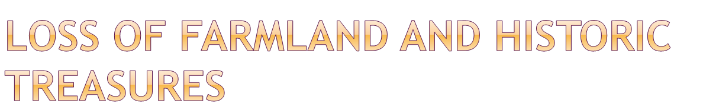
Every single year, we lose an area of productive farmland the size of Delaware (Texas, Ohio, Georgia, NC, Illinois). Best farmland must be kept in agriculture along with the control of farmland for housing and roads.
Sprawl robs city of historic treasures and characters as decaying retail centers dominates the urban landscape.

Slide 7

It erodes the city’s tax base as people flock to the suburbs, forcing cities to raise taxes on remaining taxpayers to pay for city services.
It destroys downtown commerce by pulling shoppers from once-thriving locally owned stores and restaurants to larger regional malls.

Slide 8
It increases unemployment and concentrates poverty in urban centers.
It robs cities of character as abandoned factories, boarded-up homes, and decaying retail centers dominate the landscape.

Slide 9

Comprehensive, rational planning, and strategies to combat. “Smart growth” public policies.
https://www.youtube.com/watch?v=g8Y6tYoLmKU
Land purchases (NJ—raise gasoline tax to set aside half the state’s remaining 2 million acres of open space)
Urban growth boundaries—Oregon and Washington require all communities to designate official boundaries(urban from greenbelt)

Slide 10
Revitalizing existing cities and towns-----clean up the river, convert crime-ridden neighborhood into a charming place, and encourage people to buy a home closer to their place to work (Maryland, $3000).
Transit Oriented approaches—1)Building more highways 2)Adding carpool or HOV lanes 3) Building more rail lines alongside the highways that connect cities and suburbs. Microsoft provides plush, Wi-Fi-equipped buses(Conlin, 2008)

Slide 11

A.C. Spectorsky (1957) used the term by observing residential area on the fringes of the New York City metropolitan area. Suburbs lie just outside of the city, whereas exurbs are areas farther out, beyond the suburbs.
Their lifestyles---1) commute to work 2) love for old and new 3) strong interest in books, theater, and art.
Small towns become new suburbs to new cities, dramatically alters the region. Fairfield(Connecticut), Rockland Westchester (New York), and Buck (Pennsylvania).

Slide 12

Edge city-----a new, sprawling, middle-class, automobile-dependent center typically located at the fringe of an older urban area.
Three waves of North American cities----1) the suburbanization of North America after WW II 2) Malling around 1960s and 1970s 3) Jobs moved to where we live now (Joel Garreau 1991).
Edge cities(malls and office parks) dominate the nation’s retail trade and office facilities.

Slide 13

1) Uptowns—built on top of preautomobile settlement(Passadena, California).
2) Boomers--- located at the intersection of two major highways and almost always centered on a mall.
3) Greenfields---a master-planned city by one developer on thousands of farmland acres such as Irvine, California.

Slide 14

The rise of edge cities is a function of social class (middle-class), not race.
Edge cities will grow as societies become more affluent, individualized, technology-oriented requiring air climate control.
The existence of financial centers is an important element too.

Slide 15
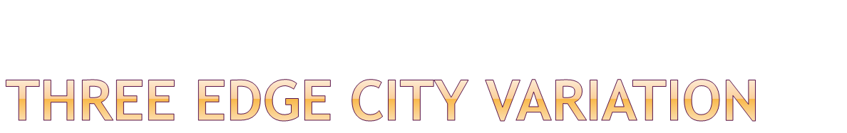
Edge city as motivator—Oshawa Center in Canada, shopping mall functioning as the village square, 40 million-dollar face-lift (retail, business, government, and community service).
Edge city as the solution---allow community to blossom. Schaumburg Illinois—home to the world headquarters of Motorola and one of Illinois’ top tourist destination.
Edge city as the problem—traffic congestion ,not pedestrian friendly, and no sense of community (Tysons Corner, Virginia).

Slide 16

Can be traced back to the late 1800s. Wealthy citizens sought to “insulate themselves from the troublesome aspects of rapidly industrializing cities (Blakely and Snyder 1997:4).
In 1960s and 1970s, master-planned retirement developments first appeared.
In the 1980s, gated communities increased rapidly in resort and country club developments. By the mid-1990s, it became common in Long Island, New York.

Slide 17
About 6% of U.S. households are in developments that are surrounded by fences or walls.
Gated communities are defended by walls, with access control either by electronically operated gates or 24-hour guards. And grounds patrolled by private security forces.
Why choose to live in gated communities 1) fear of crime 2) produce economic and physical security 3) free from the problems of traffic and noise.

Slide 18

Lifestyle communities—offer senior citizens chance to engage in variety of activities close to home. Golf and leisure communities.
Prestige communities---emphasis of exclusion and image (status-oriented).
Security-zone communities---situated in inner-city and lower-income neighborhood, the gate protect tem from crime, traffic and outsiders.

Slide 19

Robert Bellah (Habits of the Heart, 1985)—traditional communities of emotional bonds yielding to “lifestyle enclaves” such as consumption styles or leisure interests.
Robert Reich (1991)—wealth was rapidly polarizing society.
Class division, leading into racial segregation, can weaken the civic bonds among societal members.

Slide 20
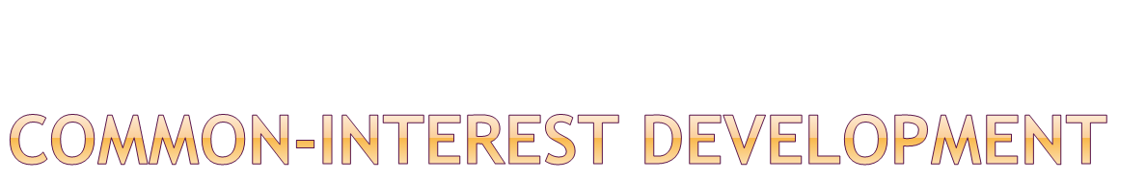
It require membership in a self-governing homeowners’ association (single family homes, urban condominiums, and housing cooperatives) and pay monthly fees, and live under the rule of residential private governments.
“cultural genocides”—the board can bar holiday decoration in windows, the size and contents of your garden, the color of paint.

Slide 21

It promotes two class society of haves and have-nots (Robert Reich).
Charles Murray views CIDs as “an urban analog of the Indian reservation”—place of deprivation and dysfunction for which they feel no responsibility.
Mark Davis (City of Quartz)—privatized Los Angeles redesigned to physically separate the two classes and protect the rich from the poor.

